Slide 1
CS2164 Lesson 10: Arrays, Pointers and Strings
Intro to programming using C
Instructor: Gustavo Sandoval
gustavo.sandoval@nyu.edu

Slide 2
HOMework

Slide 3
Assignment 4
Write a program to count the number of lines, spaces, and keywords (int, char, include, return) in a file. The program should have counters for the number of lines, spaces, ints, chars, includes, and returns, and these counters should be incremented each time they appear in the file. No other string function other than strlen can be used in the program.
See count.c

Slide 4
From last class

Slide 5
RECURSION Definition
A function is called recursive if it calls itself
To do smaller and smaller work
Recursive functions follow a pattern:
Base case
Recursive case

Slide 6
Example:
Remember about the factorial definition:
N! =>
1 if n <= 1
(n -1)! * n if n > 1
Example:
File: Factorial.c

Slide 7
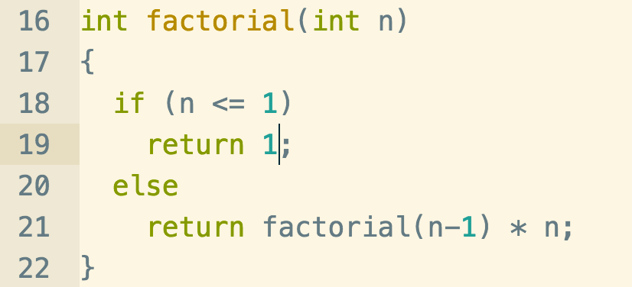
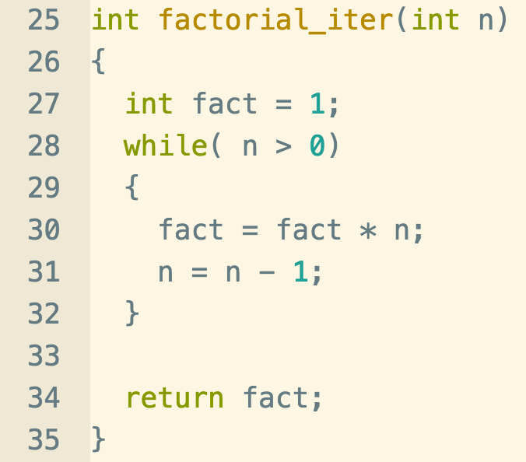
Factorial iterative vs recursive

Slide 8
Exercise
Write a recursive function called sigma with a prototype of
int sigma (int n);
that adds the numbers 1 through n and returns the sum.
Make sure that it works by also writing the iterative version
Example:
Enter a positive integer: 5
Sigma is 15
Soln:

Slide 9
Arrays, pointers and strings

Slide 10
Arrays
Programs usually often use homogeneous data. For example grades in a class.
We could do:
int grade0, grade1, grade2;
But what happens when the class has 40 people ? Doesn’t scale.
Solution:
Arrays
Example:
int grade[40]; /* declares an array of integers
Of size 40. space for grade[0] – grade[39].

Slide 11
Initialization
Initialize one by one:
float A[5] = {0.0, 1.0, 2.0, 3.0, 4.0 }
int B[3] = {1, 2, 3};
Initialize all once:
int a[100] = {0}
NOTE: Uninitialized automatic arrays *might* start with “garbage” values.
Initialize with a constant:
#define MAX
int a [MAX]

Slide 12
String and Arrays
char S[] = “hello”;
Is really shortcut for :
char S[] = {‘h’,‘e’,‘l’,‘l’,‘o’,‘\0’};
You have already been using this

Slide 13
Subscripting
To access an element of the array you use the index or the subscript.
If you declare:
Int A[5]
Valid subscripts are:
0, 1, 2, 3, 4
Remember always Size -1

Slide 14
Arrays Summary
Brackets tell the compiler that an identifier is an array
The constant inside the brackets specifies the size of the array
For example:
Int a[100]
Causes the compiler to allocate contiguous space in memory for 100 ints
The elements are numbered from 0 – 99
Example:
Arrays1.c

Slide 15
POINTERS
All variables in a program are stored in a particular memory location.
Pointers are used in programs to access memory and manipulate addresses.
If x is a variable then &x is the location or address of it’s stored value.

Slide 16
If p is a pointer. It’s declared as:
int *p;
It’s valid values are:
p = 0; /* pointing to nothing */
p = NULL; /* pointing to nothing */
p = &i; /* pointing to the address of I */
*p = 6; /* the contents of p are assigned 6 */
Notes:
Draw Diagram

Slide 17
Example:
Pointers1.c

Slide 18
Call By Reference
Let’s examine again our swap program.
Example:
Swap.c

Slide 19
Arrays and Pointers
An array name is a pointer to the first element of the array.
Pointers as well as arrays can be subscripted
Suppose A is an array, the following expressions are equivalent:
A[i] is equivalent to *(A + i)
A is a pointer to &A[0]
Example:
ArraysPointers.c

Slide 20
Arrays as function arguments
In the header to a function definition, the declaration of a parameter as an array is equivalent to its declaration as a pointer.
int a[] is equivalent to int *a
When an array is passed to a function a pointer is actually passed. The array elements themselves are not copied.

Slide 21
Example:
BubbleSort.c
Given the following array:
A = {45, 100, 5, 10, 60}
Sort it.

Slide 22
Bubble sort
How it works:
After every pass the largest element moves to the end of the array
Video:
https://www.youtube.com/watch?v=Ap0IZn4hZGk

